Slide 1
物聯記憶體科技
IoTMemory
Jan 2015

Slide 2
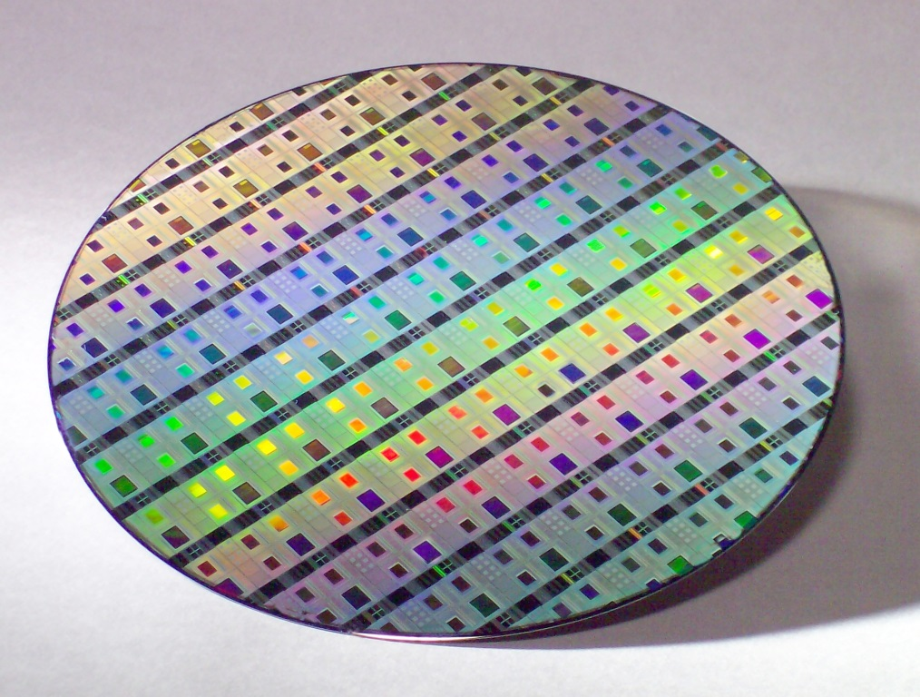

IoTMemory
繁中
简中
En
Home
About IoTMemory
Technology
Products
Applications
Careers
Contacts
Corporation Overview
Mission & Vision
IoTMemory enables your IC
fit into portable devices
Latest Update and Events
IoTMemory Technology Inc.
2015/01/19
SilvoFlash patent was officially applied in Jan 2015 in Taiwan, US and China.
IoTMemory was founded as a fabless company in Taiwan in 2014 to provide patented Flash cell, macro design (IP) and flash process support, comprising of both embedded and standalone Flash memory.
SilvoFlashTM is a versatile and quality Nor-Flash with single low voltages supply (<1.5V), low power consumption, high endurance (>100K) and high date retention (85°C@10years) to enable your IoT, MCU, smartcard and etc. function well.
1F., No.9, Ln. 166, Sanmin Rd., Songshan Dist., Taipei City 10592, Taiwan
Website: www.iotmemory.com, Email: service@iotmemory.com, TEL: +886-2-37652577,
Copyright© IoTMemory Technology Inc. All Rights Reserved

Slide 3








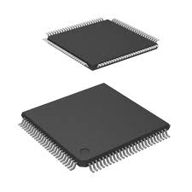
IoTMemory enables your IC
fit into portable devices
Chat 1
SilvoFlashTM is ideally suited in
IoT application
Chat 2
Customize Flash macro for
Chats should be modified
your requirements
Chat 3

Slide 4
IoTMemory
繁中
简中
En
Home
About IoTMemory
Technology
Products
Applications
Careers
Contacts
About IoTMemory
Corporation Overview
IoTMemory Technology Inc. was founded as a fabless company in Taiwan in 2014 to provide patented Flash cell, process flow support and macro design (IP), comprising of both embedded and standalone NOR Flash.
IoTMemory is started by Taiwan Flash industry experts, each with many years of experience in circuit design, device development, process engineering and marketing that will prove essential/critical/important for foundry and fabless design house’s customized and specialized demands.
IoTMemory’ SilvoFlashTM (Single Low Voltages Flash) functions with true single low voltages (1.2V or 1.5V), logic compatible, high endurance, high data retention, competitive cell size and mask layers..., which is ideally suited for IoT and low power devices.
Corporation Overview
Mission & Vision
1F., No.9, Ln. 166, Sanmin Rd., Songshan Dist., Taipei City 10592, Taiwan
Website: www.iotmemory.com, Email: service@iotmemory.com, TEL: +886-2-37652577,
Copyright© IoTMemory Technology Inc. All Rights Reserved

Slide 5
IoTMemory
繁中
简中
En
Home
About IoTMemory
Technology
Products
Applications
Careers
Contacts
About IoTMemory
Mission & Vision
Mission
Enable and inspire everyone to build a better future
Vision
To be a reliable Flash memory provider, enables customers success with cutting-edge and innovative products
Corporation Overview
Mission & Vision
1F., No.9, Ln. 166, Sanmin Rd., Songshan Dist., Taipei City 10592, Taiwan
Website: www.iotmemory.com, Email: service@iotmemory.com, TEL: +886-2-37652577,
Copyright© IoTMemory Technology Inc. All Rights Reserved

Slide 6
IoTMemory
繁中
简中
En
Home
About IoTMemory
Technology
Products
Applications
Careers
Contacts
Technology
SilvoFlashTM Overview
SilvoFlashTM means……
SilvoFlashTM Overview
SilvoFlashTM Macro Design
1F., No.9, Ln. 166, Sanmin Rd., Songshan Dist., Taipei City 10592, Taiwan
Website: www.iotmemory.com, Email: service@iotmemory.com, TEL: +886-2-37652577,
Copyright© IoTMemory Technology Inc. All Rights Reserved

Slide 7
IoTMemory
繁中
简中
En
Home
About IoTMemory
Technology
Products
Applications
Careers
Contacts
Technology
SilvoFlashTM Macro Design
SilvoFlashTM Overview
SilvoFlashTM Macro Design
1F., No.9, Ln. 166, Sanmin Rd., Songshan Dist., Taipei City 10592, Taiwan
Website: www.iotmemory.com, Email: service@iotmemory.com, TEL: +886-2-37652577,
Copyright© IoTMemory Technology Inc. All Rights Reserved

Slide 8
IoTMemory
繁中
简中
En
Home
About IoTMemory
Technology
Products
Applications
Careers
Contacts
Products
Licensed Products
• SilvoFlashTM cell patent and process license
• SilvoFlashTM design license
• SilvoFlashTM design service (customized design)
Licensed Products
Standalone Products
1F., No.9, Ln. 166, Sanmin Rd., Songshan Dist., Taipei City 10592, Taiwan
Website: www.iotmemory.com, Email: service@iotmemory.com, TEL: +886-2-37652577,
Copyright© IoTMemory Technology Inc. All Rights Reserved

Slide 9
IoTMemory
繁中
简中
En
Home
About IoTMemory
Technology
Products
Applications
Careers
Contacts
Products
Standalone Products
Licensed Products
• Serial Flash
• Parallel Flash
• Customized Flash
Standalone Products
1F., No.9, Ln. 166, Sanmin Rd., Songshan Dist., Taipei City 10592, Taiwan
Website: www.iotmemory.com, Email: service@iotmemory.com, TEL: +886-2-37652577,
Copyright© IoTMemory Technology Inc. All Rights Reserved

Slide 10
IoTMemory
繁中
简中
En
Home
About IoTMemory
Technology
Products
Applications
Careers
Contacts
Applications
Applications
*
Application
1F., No.9, Ln. 166, Sanmin Rd., Songshan Dist., Taipei City 10592, Taiwan
Website: www.iotmemory.com, Email: service@iotmemory.com, TEL: +886-2-37652577,
Copyright© IoTMemory Technology Inc. All Rights Reserved

Slide 11
IoTMemory
繁中
简中
En
Home
About IoTMemory
Technology
Products
Applications
Careers
Contacts
Careers
Why IoTMemory Technology Inc.
IoTMemory Technology Inc. has fantastic culture to innovate you to come out marvelous idea. We are always looking for talented people to join together with competitive package, a range of benefits and flexible work hours to maintain work and life balance.
Why IoTMemory
Job Opening
1F., No.9, Ln. 166, Sanmin Rd., Songshan Dist., Taipei City 10592, Taiwan
Website: www.iotmemory.com, Email: service@iotmemory.com, TEL: +886-2-37652577,
Copyright© IoTMemory Technology Inc. All Rights Reserved

Slide 12
IoTMemory
繁中
简中
En
Home
About IoTMemory
Technology
Products
Applications
Careers
Contacts
Careers
Job Opening
Io
Why IoTMemory
Job Opening
1F., No.9, Ln. 166, Sanmin Rd., Songshan Dist., Taipei City 10592, Taiwan
Website: www.iotmemory.com, Email: service@iotmemory.com, TEL: +886-2-37652577,
Copyright© IoTMemory Technology Inc. All Rights Reserved

Slide 13
IoTMemory
繁中
简中
En
Home
About IoTMemory
Technology
Products
Applications
Careers
Contacts
Contacts
IoTMemory Contacts
Alan Cheng Director of Business Development IoTMemory Technology Inc.
Mobile : | +886-958961415 (Taiwan) +65-97528555 (Singapore)
Email : | alancheng@iotmemory.com
Headquarters
TEL : | +886-2-37652577
Fax : | +886-2-37652579
Address : | 1F., No.9, Ln. 166, Sanmin Rd., Songshan Dist., Taipei City 10592, Taiwan 台北市松山區三民路166巷9號1樓
Website : | http://www.iotmemory.com
IoTMemory
Partner
1F., No.9, Ln. 166, Sanmin Rd., Songshan Dist., Taipei City 10592, Taiwan
Website: www.iotmemory.com, Email: service@iotmemory.com, TEL: +886-2-37652577,
Copyright© IoTMemory Technology Inc. All Rights Reserved

Slide 14
IoTMemory
繁中
简中
En
Home
About IoTMemory
Technology
Products
Applications
Careers
Contacts
Contacts
Partner Contacts
*
IoTMemory
Partner
1F., No.9, Ln. 166, Sanmin Rd., Songshan Dist., Taipei City 10592, Taiwan
Website: www.iotmemory.com, Email: service@iotmemory.com, TEL: +886-2-37652577,
Copyright© IoTMemory Technology Inc. All Rights Reserved

Slide 15
IoTMemory
Thanks

